Slide 1
Visual Studio 2017 Version 15.3 and later
Guide for Installation and Running C++ Code

Slide 2
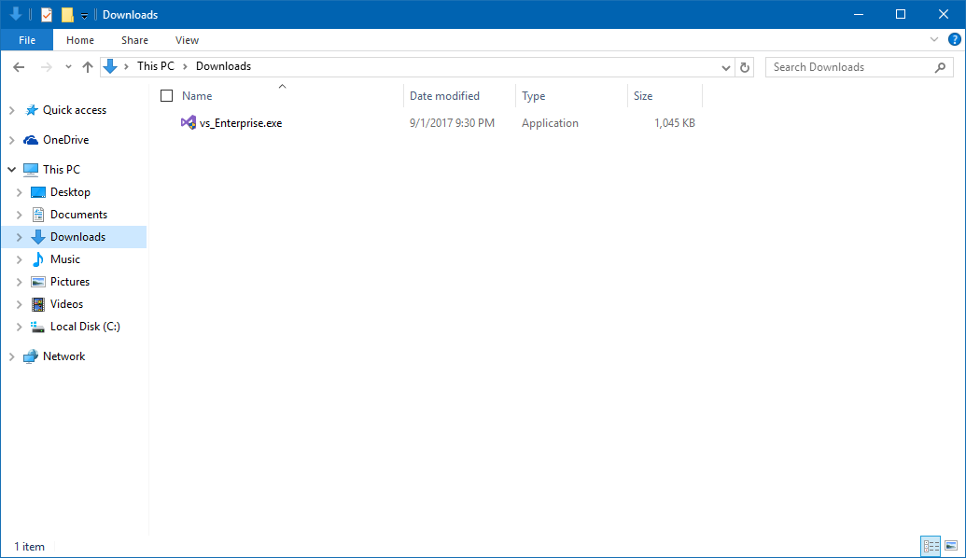
Installation
Double click the installer and to start the installation process.

Slide 3
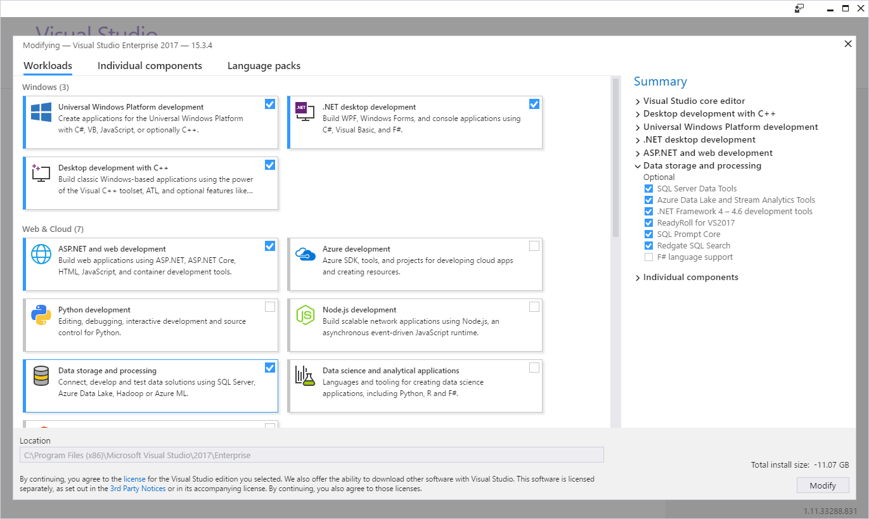
Installation Continued
Install the following workloads for C++ and C#.

Slide 4
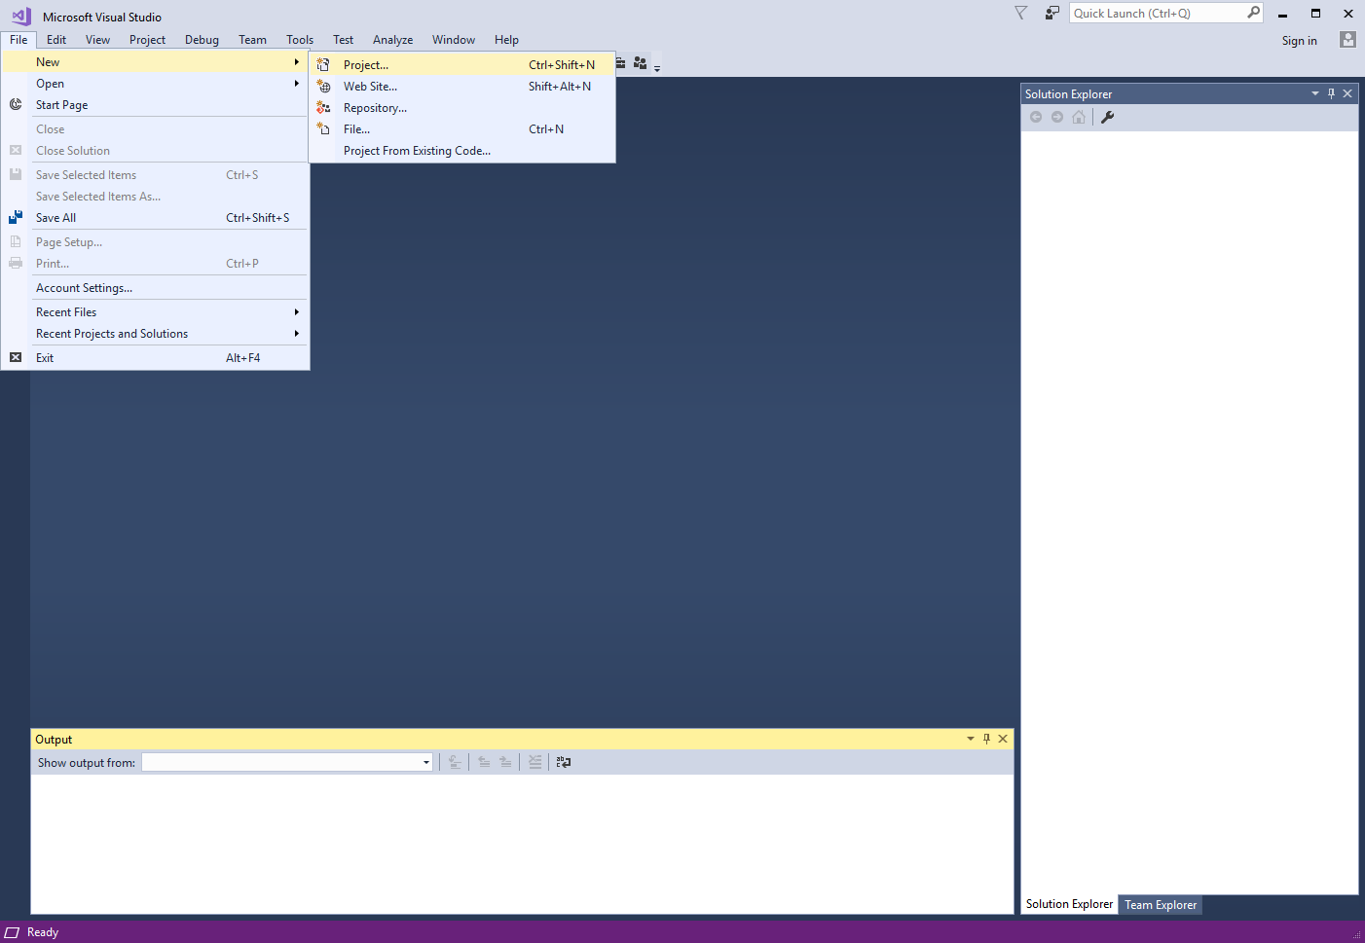
Running C++ Code in Visual Studio
Click:
File > New > Project

Slide 5
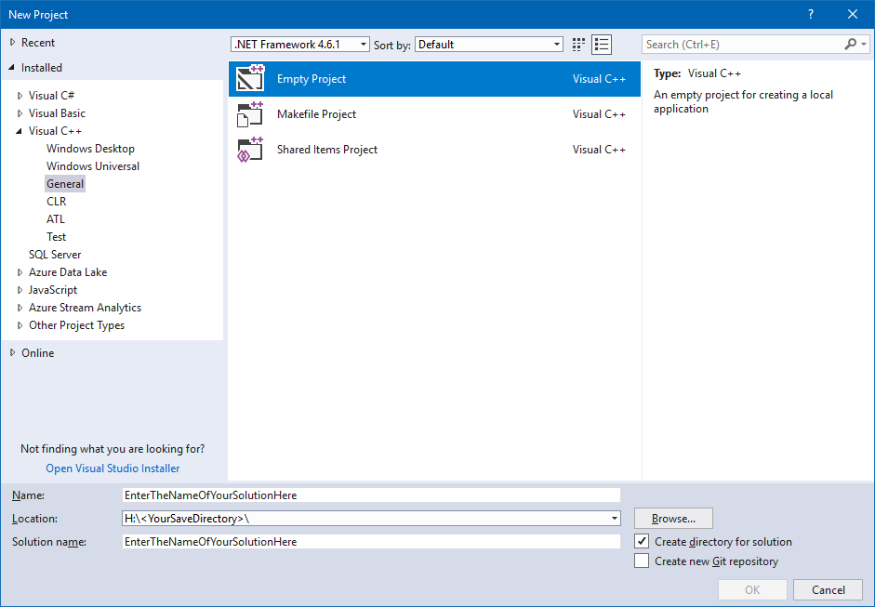
Click:
Visual C++ > General > Empty Project
Then:
Enter The Name Of Your Project In Name:
Last:
Choose The Directory Where You Will Save Your Project

Slide 6
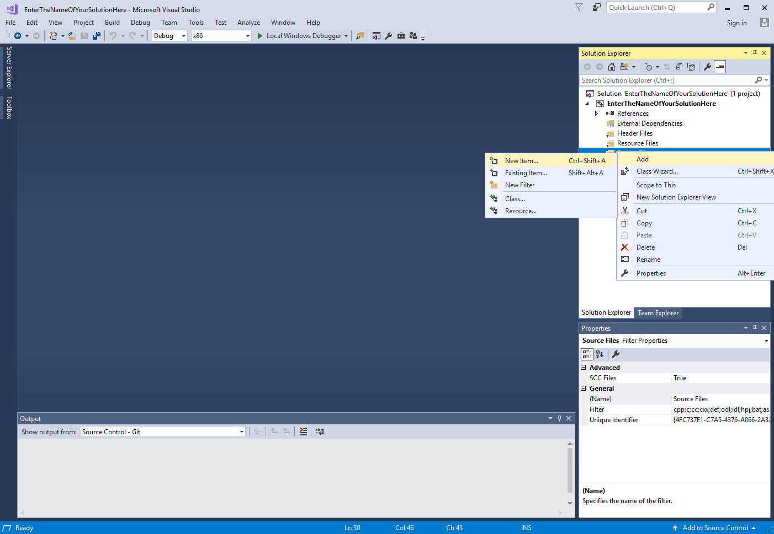
For new source files right click on Source Files and click:
Add > New Item

Slide 7
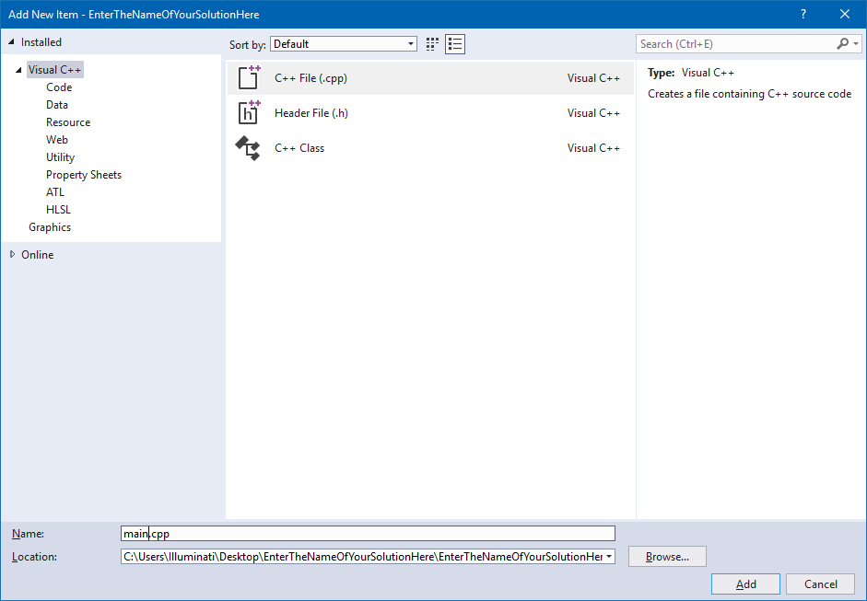
Select C++ File (.cpp) and then rename the file.

Slide 8
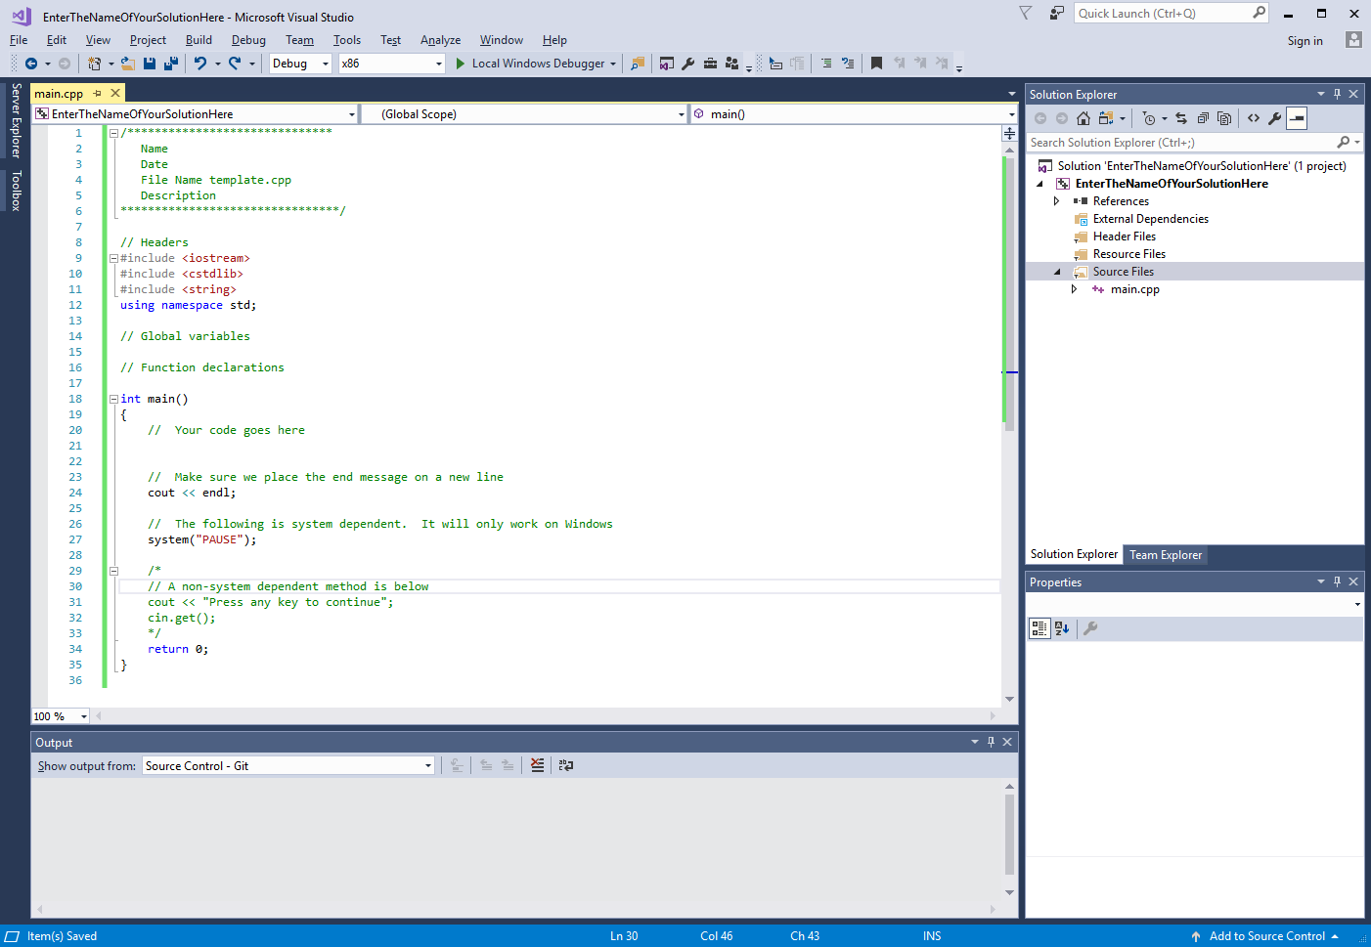
This is a C++ Template File that you can make for your projects.

Slide 9
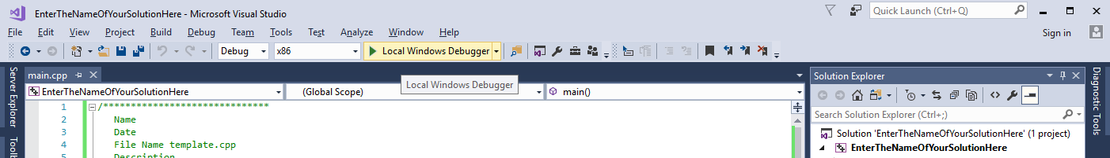
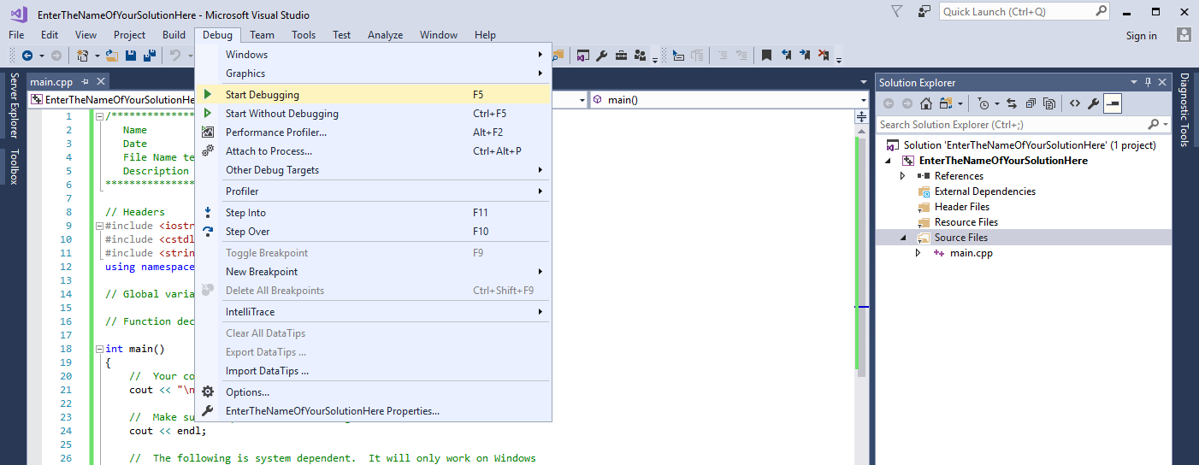
To run your Project follow either one of these.
Or

Slide 10
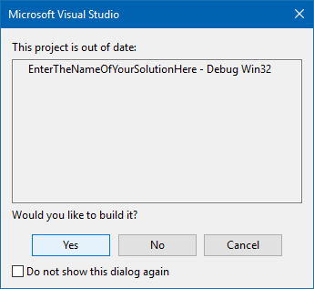
Click Yes if you see this screen.

Slide 11
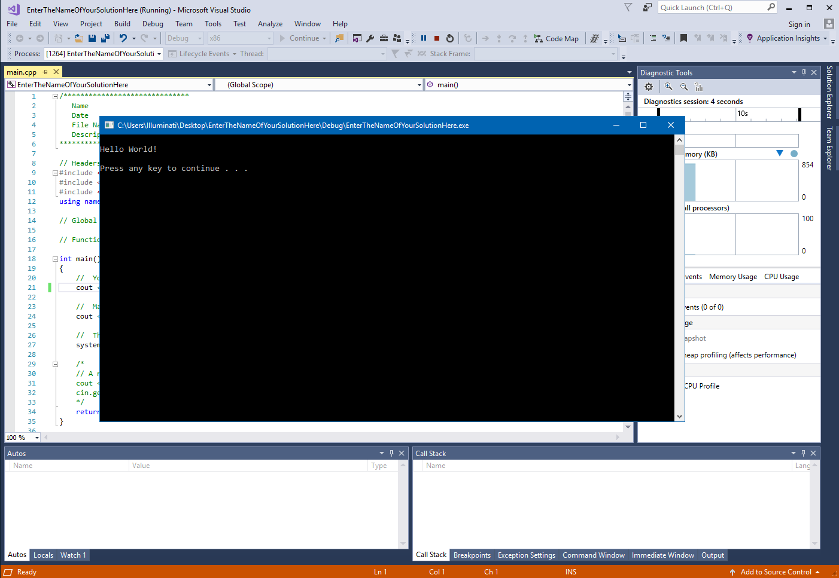
This is an example of a running C++ project.

